Slide 1
Lecture 10: Key Exchange
An Introduction to Information Security
School of Big Data and Software Engineering, CQU
Fall, 2018

Slide 2



Quickly Review
Lecture 9
Key Distribution
Very important for symmetric key cipher
KDC
KDC
Secure Channel
(1) ID_{A} || ID_{B} || N₁
A
C
(2) E_{Ka} [ K_{s} || ID_{B} || N₁ || E_{Kb} [K_{s}|| ID_{A}] ]
B
(3) E_{Kb} [ K_{s} || ID_{A} ]
(4) E_{Ks} [ N₂ ]
A
(5) E_{Ks} [ f(N₂) ]
B
Needham/Schreoder协议

Slide 3
基于对称密码的认证
Needham/Schreoder 认证协议： KDC
KDC
(1)ID_{A} || ID_{B} || N₁
(2) E_{Ka} [ K_{s} || ID_{B} || N₁ || E_{Kb} [K_{s}|| ID_{A}] ]
(3) E_{Kb} [ K_{s} || ID_{A} ]
(4) E_{Ks} [ N₂ ]
A
(5) E_{Ks} [ f(N₂) ]
B

Slide 4
基于对称密码的认证
Denning认证协议 : timestamps
KDC
(1) ID_{A} || ID_{B}
(2) E_{Ka} [ K_{s} || ID_{B} || T || E_{Kb} [K_{s}|| ID_{A} || T ] ]
(3) E_{Kb} [ K_{s}|| ID_{A} || T ]
(4) E_{Ks} [ N₁ ]
A
(5) E_{Ks} [ f(N₁) ]
B

Slide 5
基于对称密码的认证
Neuman协议
KDC
(3) E_{ka} [ ID_{B} || N_{a} || K_{s} || T_{b} ] || E_{kb} [ ID_{A} || K_{s} ||T_{b} ] || N_{b}
(2) ID_{B} || N_{b} || E_{Kb} [ ID_{A} || N_{a} || T_{b}] ]
(1) ID_{A} || N_{a}
(4) E_{kb} [ ID_{A} || K_{s} ||T_{b} ] || E_{ks} [N_{b}]
A
B

Slide 6

Outline
6
Lecture 10. Key Exchange
Lecture 11. Public Key Encryption
2018/10/16
An Introduction to Information Security

Slide 7
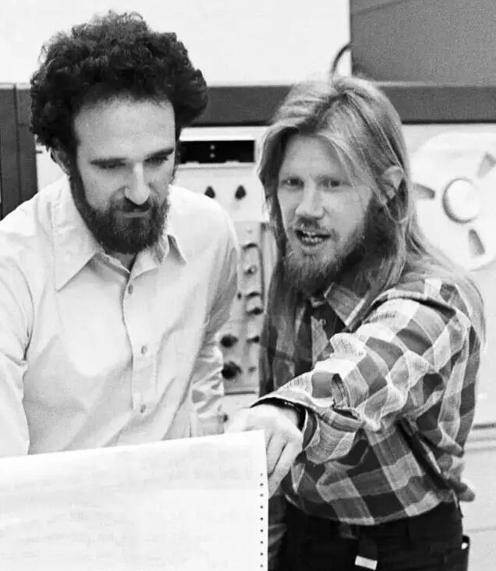
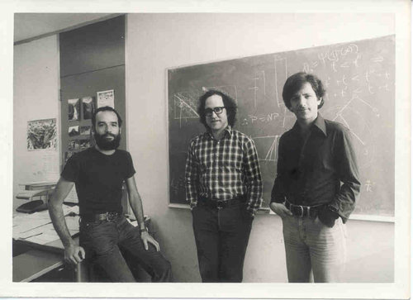
5 Figures

Slide 8
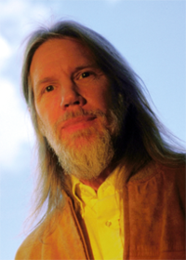
Lecture 10: Key Exchange
Dr. Whitfield Diffie
born in 1944, fascinated(着迷) by mathematics as a child
graduated from the MIT in 1965, majoring mathematics
Manager of Secure System Research in Northern Telecom (Nortel Networks) before 1991
Chief Security Officer of Sun Microsystems since then
ARPANet
Diffie was particularly interested in the key distribution problem, and by the early 1970s he had matured into one of the few truly independent security experts, a freethinking cryptographer, not employed by the government or by any of the big corporations.
Diffie-Hellman Key Exchange (Section 10.1)
迪菲•赫尔曼密钥交换协议

Slide 9
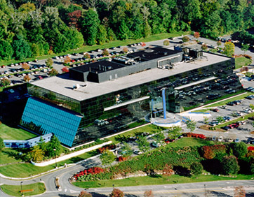
Lecture 10: Key Exchange
In 1974, Diffie paid a visit to IBM’s Thomas J. Watson Laboratory (IBM华生实验室), where he had been invited to give a talk.
He spoke about various strategies(策略) for attacking the key distribution problem, and there was no positive reaction from his audience.
When finished his talk, Diffie was told that someone else had recently visited the Lab and given a lecture that addressed the issue of key distribution.
The speaker’s name is Martin Hellman, a professor from
Stanford University(斯坦福大学)
IBM 托马斯.华生 实验室

Slide 10
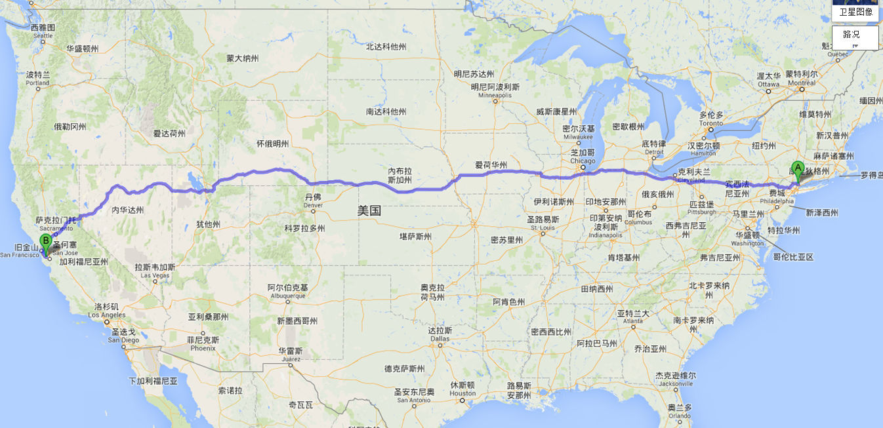
Lecture 10: Key Exchange
10

Slide 11
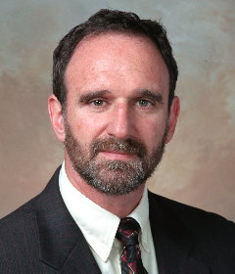
Lecture 10: Key Exchange
Prof. Martin Hellman
born in 1945 in a Jewish(犹太人) neighborhood
“Who would want to be like everybody else?”
His colleagues criticized him he was crazy to compete with the NSA and their multibillion-dollar budget
when Diffie called him, Hellman never heard about this stranger, but grudgingly(勉强地) agreed to a half-hour appointment later that afternoon… Diffie left Hellman’s house around midnight
Diffie then enrolled(加入,入学) as his graduate student since Hellman did not have a great deal of funding to employ him as a researcher.
God rewards fools…

Slide 12

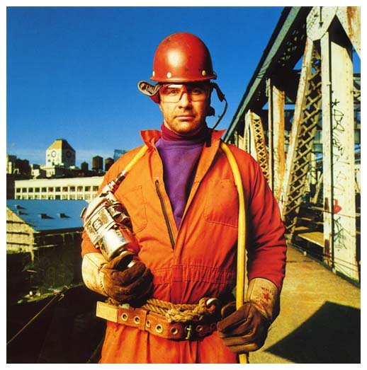
Lecture 10: Key Exchange
Alice
Bob
Suppose that Alice and Bob live in a country where the postal(邮政) system is completed immoral(不道德的), and postal employees will read any unprotected messages.
Alice wants to send an intensely(热情的) personal message to Bob…
NO KEY NEEDED TO BE DISTRIBUTED！

Slide 13
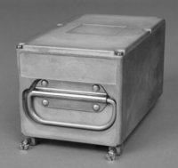
Lecture 10: Key Exchange
Alice
Bob
It seems that the problem of key distribution might have been solved, because the encrypted scheme requites no exchange of keys.
However, there is a fundamental difference between locks/unlocks and encryption and decryption:
F_{x}(F_{y}(M)) ≠ F_{y}(F_{x}(M))
In general, the order of encryption and decryption is crucial: Last on, First off (后进先出)
ALICE & BOB’S STRATEGY

Slide 14
Lecture 10: Key Exchange
HELLMAN’S CONTRIBUTION
Although the padlocked box approach would not work for real world cryptography, it inspired Diffie and Hellman to search for a practical method of circumventing(回避) the key distribution problem.
They spent month after month attempting to find a solution.
They focused their attention on one-way function(单向函数)…
并且满足：F_{x}(F_{y}(M)) = F_{y}(F_{x}(M))
Two years of thinking came to pay when Hellman was working at home late one night.
In half an hour of frantic scribbling(疯狂演算), he proved that Alice and Bob could agree on a key without meeting!

Slide 15
Lecture 10: Key Exchange
10.2 Diffie-Hellman Key Exchange
Hellman’s idea relied on an one-way function of the form:
Initially, Alice and Bob agree on values for g and p. Almost any values are fine (but g < p, ) p is a prime number(素数).
These values are not secret, so Alice can telephone Bob and suggest that, say, g = 7 and p = 11.
Alice and Bob have now agreed on the one-way function:
At this point they can begin the process of trying to establish a secret key without meeting!

Slide 16
Lecture 10: Key Exchange
THE BASIC SCHEME
Alice choose a number,
say 3, and keep it secret.
We label her number A
Bob choose a number, say 6,
and keep it secret. We label
his number B
Step 1

Slide 17
Lecture 10: Key Exchange
THE BASIC SCHEME
Alice puts A=3 into the one-
way function and works
out the result:
Bob puts B=6 into the one-way
function and works out the
Result:
Step 2
2
4

Slide 18
Lecture 10: Key Exchange
THE BASIC SCHEME
Alice sends her result
to Bob
Bob sends his result to Alice
Step 3
It does not matter that somebody eavesdrop these conversations because 2 and 4 are not the key.

Slide 19
Lecture 10: Key Exchange
THE BASIC SCHEME
This is the key!
Alice take Bob’s result, and
works out the result of
Bob sends his result to Alice
Step 4
9
9
Alice and Bob have ended up with the same number, 9.
This idea is called Diffie-Hellman Key Exchange Scheme

Slide 20

Lecture 10: Key Exchange
Diffie-Hellman Key Exchange Scheme
Agree on Global Public Elements
p：is a prime number
g：g<p, g is a primitive root of p
Q1: What‘s prime number?
Q2: What‘s primitive root (本原根)?

Slide 21
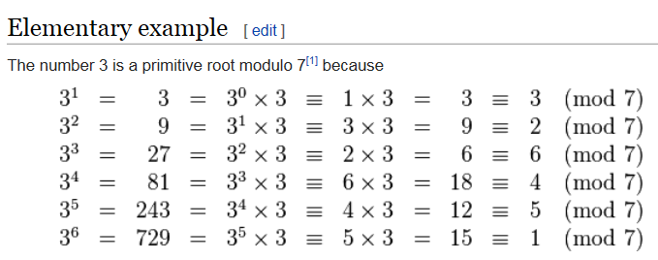
Lecture 10: Key Exchange
Diffie-Hellman Key Exchange Scheme
Agree on Global Public Elements
p：is a prime number
g：g<p, g is a primitive root of p
Q2: What‘s primitive root (本原根)?
Wikipedia: Gauss defined primitive roots in 1801 based on Euler’s work….
Baidu: 如果g是素数p的原根，则数g mod p, g² mod p, … , g^{p-1} mod p 是不同的并且包含1到p-1的整数的某种排列。

Slide 22
Lecture 10: Key Exchange
Diffie-Hellman Key Exchange Scheme
Agree on Global Public Elements
p：is a prime number
g：g<p, g is a primitive root of p
For Alice
Selected private: A, ( A<p )
Calculate public α=g^{A} mod p
For Bob
Selected private B, ( B<p )
Calculate public β=g^{B} mod p
Key= β^{A} mod p
Key= α^{B} mod p

Slide 23
Lecture 10: Key Exchange
Diffie-Hellman Key Exchange Scheme
Agree on Global Public Elements
p：is a prime number
g：g<p, g is a primitive root of p
For Alice
Selected private: A, ( A<p )
Calculate public α=g^{A} mod p
For Bob
Selected private B, ( B<p )
Calculate public β=g^{B} mod p
Key= β^{A} mod p
Key= α^{B} mod p
Key = α^{B} mod p = β^{A} mod p
= (g^{A} mod p)^{B} mod p =(g^{B} mod p)^{A} mod p
= g^{AB} mod p = g^{BA} mod p
Q3:如何证明?

Slide 24
Lecture 10: Key Exchange
Diffie-Hellman Key Exchange Scheme
Agree on Global Public Elements
p：is a prime number
g：g<p, g is a primitive root of p
For Alice
Selected private: A, ( A<p )
Calculate public α=Y^{A} mod p
For Bob
Selected private B, ( B<p )
Calculate public β=Y^{B} mod p
Key= β^{A} mod p
Key= α^{B} mod p
已知g, p和α, β；可否求出A, B?
根据α = g^{A} mod p，求A，
离散对数问题(当p很大时，求解难度很大)
Q4:它安全吗?

Slide 25
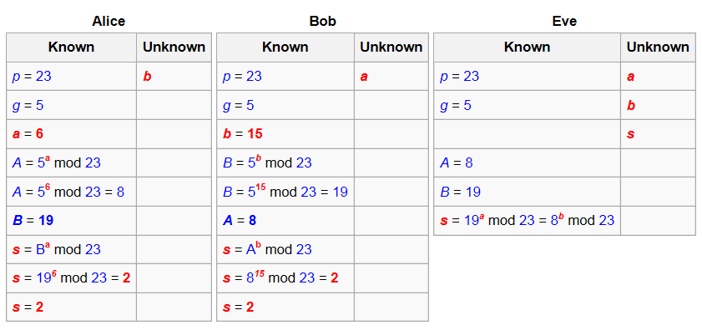
Lecture 10: Key Exchange
Diffie-Hellman Key Exchange Scheme

Slide 26
Lecture 10: Key Exchange
BUT THERE IS STILL A PROBLEM
The Hellman’s algorithm was a gigantic leap forward(飞跃), the system was not perfect because it was inconvenient.
Why?
Imagine that Alice lives in U.S. and Bob lives in China.
Alice wants to send an e-mail to Bob, but Bob is probably asleep.
If Alice wants to encrypt her message, then she needs to agree a key with Bob on-line, or, she has to wait for 12 hours when Bob wakes up.
So far, all encryptions we have talked about are
Symmetric encryptions

Slide 27
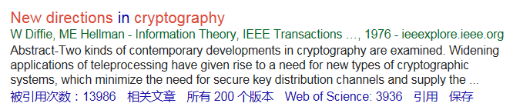
Lecture 10: Key Exchange
DIFFIE’S CONTRIBUTION
Diffie had concocted(捏造,提出) a new type of cipher, one that incorporated a so-called asymmetric key.
New Directions in Cryptography！
The encryption key and the decryption key are not identical(同一的).
Alice could create her own pair of keys:
an encryption key
an decryption key
Alice keeps the decryption key secret, so it is commonly referred to as Alice’s private key.
She publishes the encryption key so that everybody has access to it, which is commonly referred as Alice’s public key.

Slide 28


Lecture 10: Key Exchange
DIFFIE’S CONTRIBUTION
Alice
Bob
Plaintext
Plaintext
Encryption Algorithm
Bob’s Public-Key
Bob’s
Private-Key
Decryption Algorithm
Ciphertext
Ciphertext
Insecure Channel

Slide 29
Lecture 10: Key Exchange
DIFFIE’S CONTRIBUTION
The great advantage of this system is that there is no wasted time that Bob has to wait to get information from Alice before he can encrypt and send a message to her.
Alice does not have to transport the public encryption key securely to Bob: in complete contrast, she can now publicize her public ( for encryption) key as widely as possible so that the whole world can use it to send her encrypted messages.
At the same time, even if the whole world knows Alice’s public key, none of them can decrypt a message using Alice’s public key.
Only Alice can decrypt them using her own private key.

Slide 30
Lecture 10: Key Exchange
BUT…
Is the idea first proposed by Diffie and Hellman?
Diffie did not actually have a specific example of this public/private key scheme.
In UK by J Ellis, C. Cocks and M. Williamson, 1960’s
however, his idea was revolutionary.
Hellman and Diffie published their studies in 1975~1976
they (and many many other cryptographers) continued their research, attempting to find a special one-way function that would make asymmetric ciphers a reality.
however, they failed to make the discovery.
the race to find an asymmetric cipher was won by another research group, back to Diffie’s mother school, MIT.

Slide 31
Lecture 10: Key Exchange
麻省理工学院“三杰”是如何接过接力棒的?

Slide 32
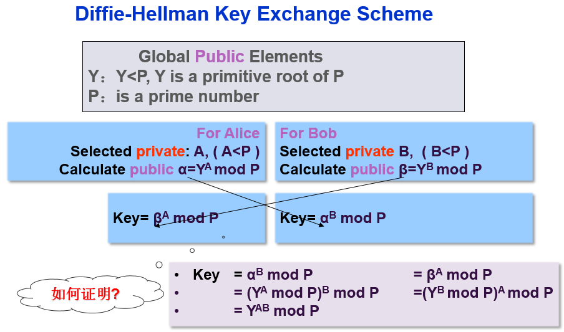
Lecture 10: Key Exchange
Summary
D-H Key Exchange

Slide 33
An Introduction to Information Security
Thanks for your attention!
Q&A

